Slide 1


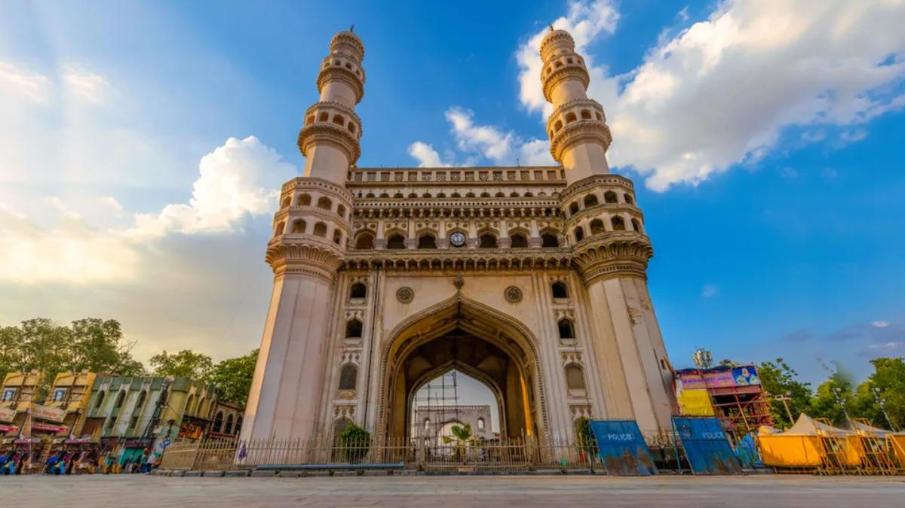

Telangana Government
Presentation 2023
PROJECT PRESENTATION
RUTESH SHINDE

Slide 2
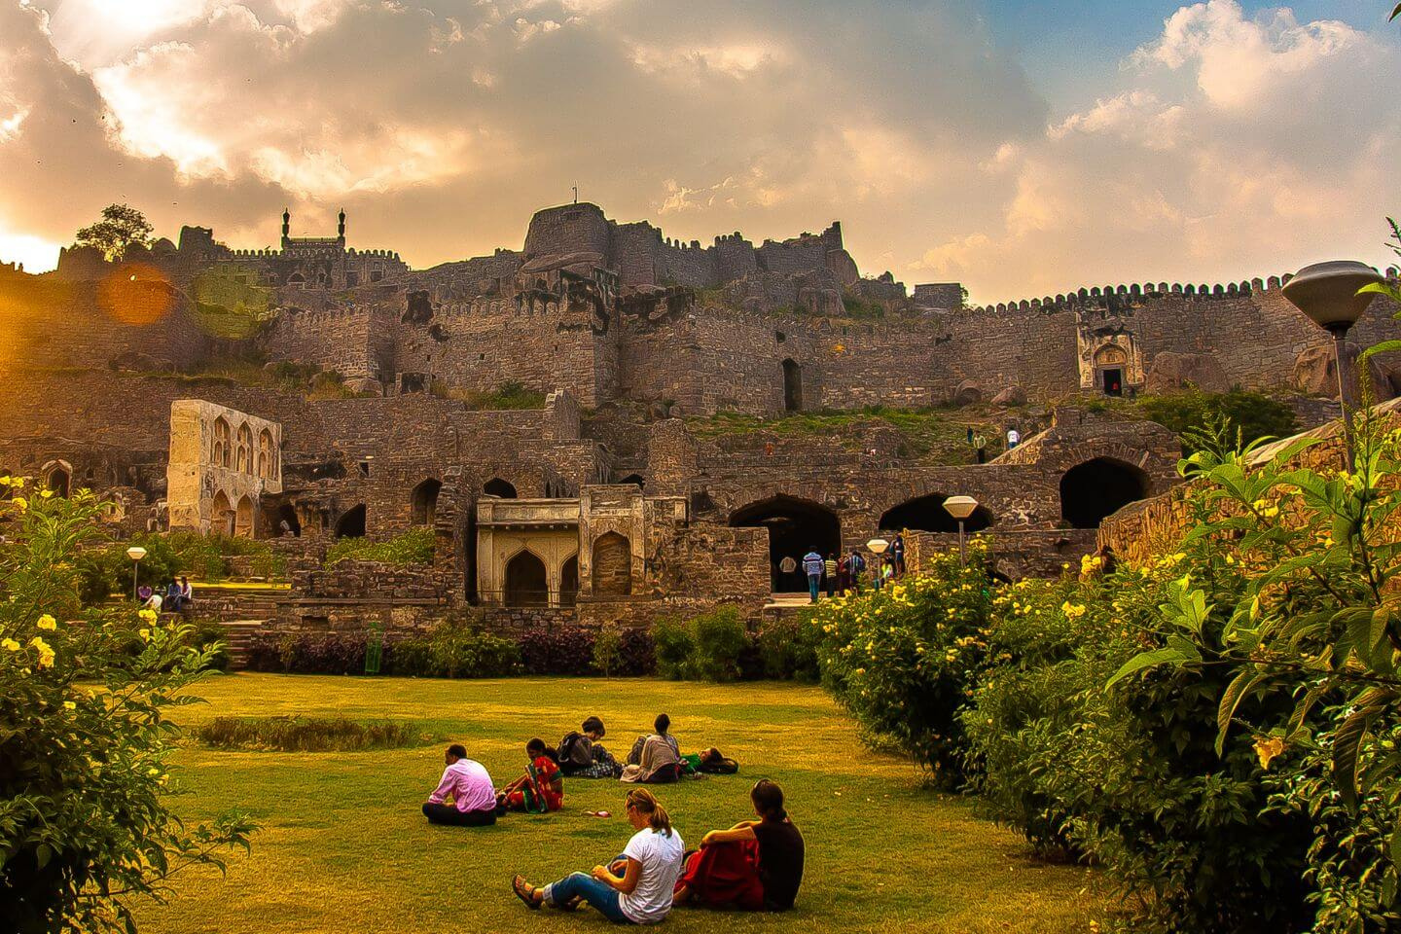
Content
01
Overview
02
Understanding Problem Statment
03
Providing Insights
04
Exploring Power BI Dashboard
05
Recommendation to the officals
06
ThankYou

Slide 3





Overview
Benfits of this challange
Every successful submission to get a joint appreciation certificate from codebasics and Open Data Telangana
Top 5 winners to get a letter of recognition from Open Data Telangana
Internship Possibilities with Open Data Telangana

Slide 4







PROBLEM STATEMENT
Analyse Growth and Present Insights to the Telangana Government
MySql
Power Bi
Excel
PowerPoint
ChatGPT
Used Mysql for Analysing data in SQL
Used Power BI to create Interactive Dashboard
A Little bit of data cleaning in Excel
PowerPoint for presentation
Used ChatGPT as my second brain

Slide 5


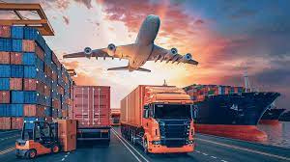

Providing Insights
Stamp Registration
Transport
TS-iPASS

Slide 6
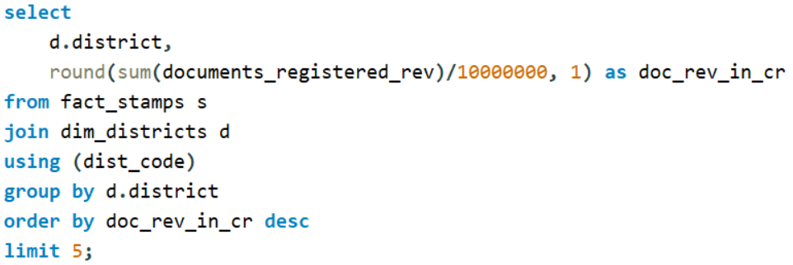
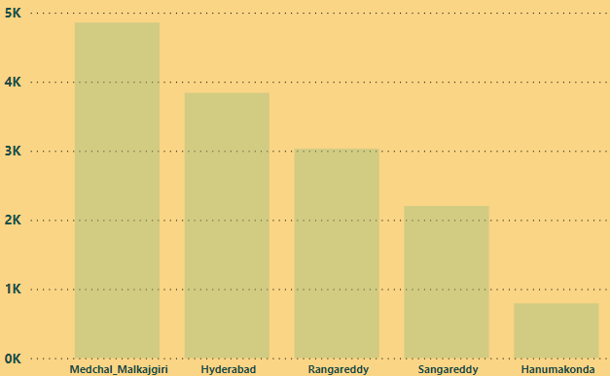
Stamp Registration
1. How does the revenue generated from document registration vary across districts in Telangana? List down the top 5 districts that showed the highest document registration revenue growth between FY 2019 and 2022.

Slide 7
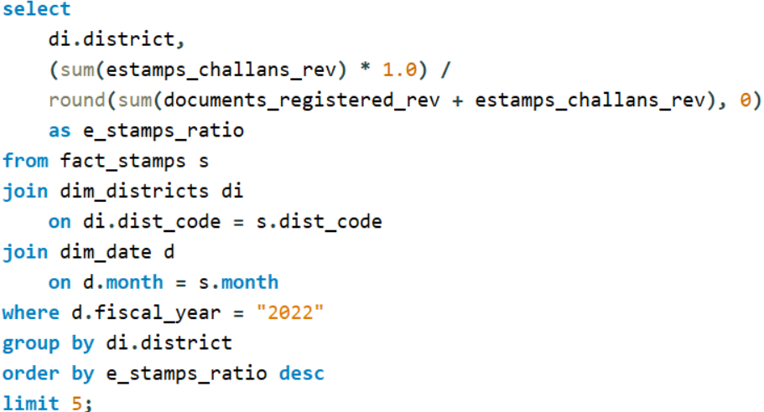
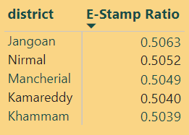
2. How does the revenue generated from document registration compare to the revenue generated from e-stamp challans across districts? List down the top 5 districts where e-stamps revenue contributes significantly more to the revenue than the documents in FY 2022?

Slide 8
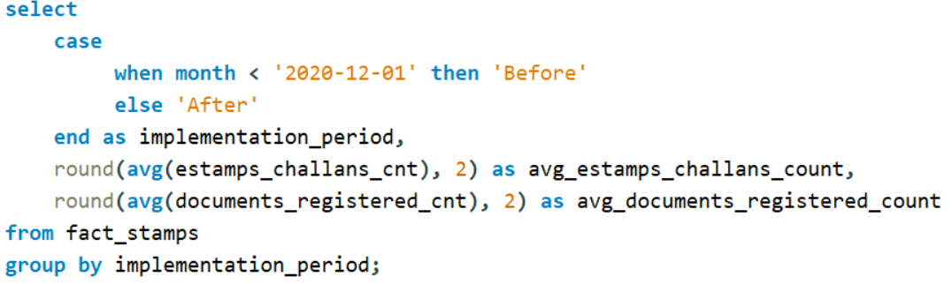
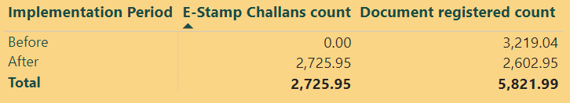
3. Is there any alteration of e-Stamp challan count and document registration count pattern since the implementation of e-Stamp challan? If so, what suggestions would you propose to the government?

Slide 9
4. Categorize districts into three segments based on their stamp registration revenue generation during the fiscal year 2021 to 2022.

Slide 10
Transport
5. Investigate whether there is any correlation between vehicle sales and specific months or seasons in different districts. Are there any months or seasons that consistently show higher or lower sales rate, and if yes, what could be the driving factors? (Consider Fuel-Type category only)

Slide 11
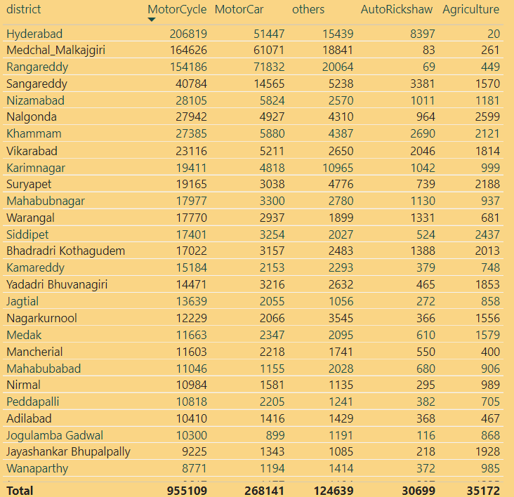
6. How does the distribution of vehicles vary by vehicle class (MotorCycle, MotorCar, AutoRickshaw, Agriculture) across different districts? Are there any districts with a predominant preference for a specific vehicle class? Consider FY 2022 for analysis.

Slide 12
7. List down the top 3 and bottom 3 districts that have shown the highest and lowest vehicle sales growth during FY 2022 compared to FY 2021? (Consider and compare categories: Petrol, Diesel and Electric)

Slide 13
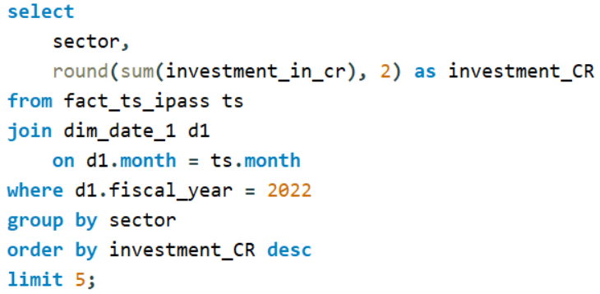
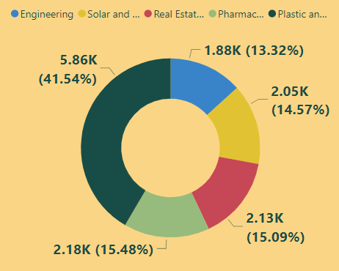
TS-iPass
8. List down the top 5 sectors that have witnessed the most significant investments in FY 2022.

Slide 14
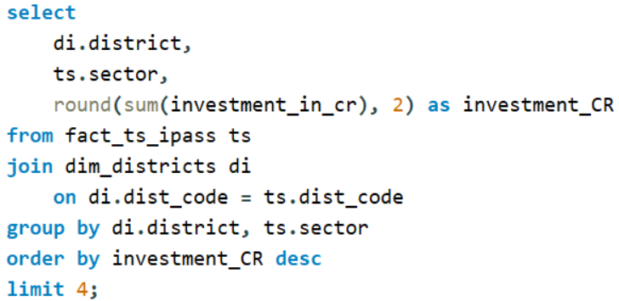
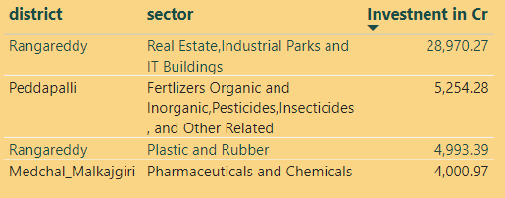
9. List down the top 3 districts that have attracted the most significant sector investments during FY 2019 to 2022? What factors could have led to the substantial investments in these particular districts?

Slide 15
10. Is there any relationship between district investments, vehicles sales and stamps revenue within the same district between FY 2021 and 2022?

Slide 16
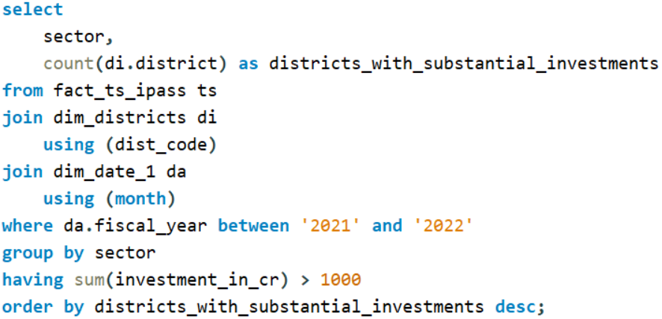
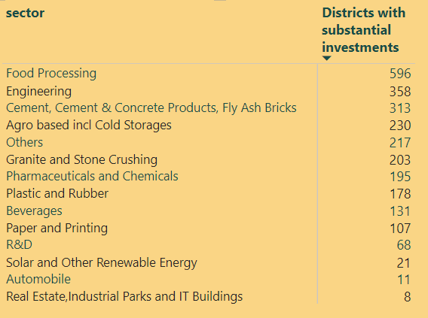
11. Are there any particular sectors that have shown substantial investment in multiple districts between FY 2021 and 2022?

Slide 17
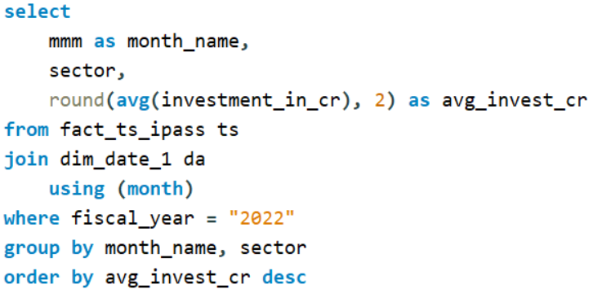
12. Can we identify any seasonal patterns or cyclicality in the investment trends for specific sectors? Do certain sectors experience higher investments during particular months?

Slide 18

EXPLORE POWER BI DASHBOARD

Slide 19
RECOMMEDATION TO THE GOVERMENT OFFICALS

Slide 20
1. What are the top 5 districts to buy commercial properties in Telangana?

Slide 21
2. What significant policies or initiatives were put into effect to enhance economic growth, investments, and employment in Telangana by the current government? Can we quantify the impact of these policies using available data?

Slide 22
THANK YOU

